Slide 1
ERASMUS
Committee Meeting
23 July 2019
2013
2016
Notes:
21:47
AGÜ Gençlik Fabrikası
Gençler için gençlerle birlikte daha iyi bir topluma...
Türkiye’de bir ilk olan Gençlik Fabrikası:
• gençleri eğiten,
• yaratıcı ve girişimci olmaya teşvik eden,
• gençlere yaşama dair beceriler kazandıran,
• uluslararası vizyon katan,
• gençlerin toplumsal hayata katılımını sağlayıp bir arada öğrenmenin ve üretmenin keyfine vardıran,
• ulusal ve uluslararası boyutta faaliyet gösteren öğrenen odaklı bir yapıdır.

Slide 2
Agenda Items
Erasmus Staff Presentations
Erasmus Staff Exchange Selections
Discussion on the next plans and meetings
2013
2016

Slide 3
Staff Mobilty@AGU 2018-2020
 | Number | Dates
Teaching Mobility | 5(after report we received 4) | Until May 2020
Training Mobility | 1+1(We received 1 extra) | Until May 2020
2013
2016

Slide 4
New Applications
Name | Department | Experience | Country | Institution | Dates | Mobility Type
Benay Uzer | Mechanical Engineering | 20 months | Germany | Helmholtz-Zentrum Geesthact | 12-23 August 2019 | Training
Sinan Genç | EEE | 6 years | Finland | Tampere University | 4-10 August 2019 | Training
Eyüp Özkan | Architecture | 10 months | UK | University of Oxford | 22-26 July 2019 | Training
Harika Süklün | Business Administration | 1 year and 10 months | France | Brest Business School | March or April in 2020 | Teaching
Özgür Aydın | Mechanical Engineering | 5 months | UK | Newcastle University | 13-17 April 2020 | Teaching
2013
2016

Slide 5
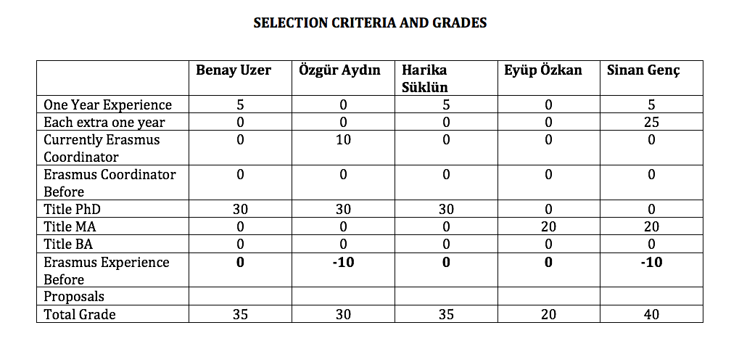
New Applications
2013
2016

Slide 6
Erasmus@AGU 2018-2020
Criteria for staff mobility:
At least one year of work experience at AGU: + 5 points
For each extra year of work experience at AGU: + 5 points
Currently, Erasmus Department Coordinator/Assistant: +10 points
Previous Erasmus Department Coordinator/Assistant: + 5 points
First time Erasmus applicant: +30 points
Academic personnel of Faculties/Schools with Ph.D. Titles: +30 points
Support academic personnel of Faculties/Schools with M.Sc./M.A Titles: +20 points
Support academic personnel of Faculties/Schools with B.Sc./B.A Titles: +10 points
2013
2016

Slide 7
Erasmus@AGU 2018-2020
Criteria for staff mobility:
Language Level 1 : + 40 points for KPDS/YDS .GE. 90, TOEFL IBT .GE. 108
Language Level 2 : + 30 points for KPDS/YDS .GE. 80, TOEFL IBT .GE. 96
Language Level 3 : + 20 points for KPDS/YDS .GE. 70, TOEFL IBT .GE. 84
Language Level 4 : + 10 points for KPDS/YDS .GE. 60, TOEFL IBT .GE. 72
Here .GE. stands for “Greater than or Equal to”. One can get a Language Point from only one of the Language Levels.
For presentation proposals that introduces the research activities, their budgets and the project based RA scholarships at AGU: +10 points
For presentation proposals that promotes the joint research collaborations between the two institutions: +10 points
For presentation proposals that promotes graduate studies at AGU for candidate grad students: +10 points
For presentation proposals that promotes academic exchange activities between the two institutions: +10 points
For presentation proposals that promotes undergrad and grad student exchange activities between the two institutions: +10 points
2013
2016

Slide 8
What’s next?
Next Call
Next Committee Meeting
2013
2016

Slide 9
Thank you for your participation!
2013
2016

